Slide 1
Estimation And Prediction Of Patient Length Of Stay
Group14：Ya Wang, Yu Qing, Suyuan Wang, Yile Zhu
Notes:
Good afternoon everyone

Slide 2
1. Introduction 2. Methodology 3. Results 4. Improvements

Slide 3
Introduction

Slide 4

Introduction
Importance of Length of Stay (LOS):
Key metric in healthcare impacting hospital resource use, operational efficiency, and patient outcomes.
Current Challenges:
Rising healthcare costs and patient volumes
Focus of Research:
Leveraging statistical models and machine learning to accurately predict LOS.
Notes:
Length of Stay, or LOS, is a critical metric in healthcare, directly impacting hospital resource use, operational efficiency, and patient outcomes./ˈʌltɪmətli/ . However, with rising healthcare costs and increasing patient volumes /ˈvo u mz/, managing LOS has become a growing challenge. To address this, recent research focuses on leveraging statistical models and machine learning techniques
/tekˈniːks/to accurately predict LOS. This approach aims to optimize resource allocation and improve the overall efficiency of healthcare services.

Slide 5
Introduction
Related Literature
Traditional Methods:
Linear regression, decision trees analyze patient demographics and treatment data. Xie et al. (2020) used multivariate regression, highlighting age, admission reason, and medical costs as key factors influencing LOS.
Machine Learning :
Chen et al. (2019): Random forest and neural networks achieved high prediction accuracy.
Insight: Machine learning shows strong potential for improving LOS predictions.
Notes:
In our literature review, we found that Traditional methods, like linear regression and decision trees, analyze patient demographics /ˌdeməˈɡræfɪks/ and treatment data. Xie et al. (2020) identified age, admission reason, and medical costs as key factors influencing LOS. Recent studies, such as Chen et al. (2019), show that machine learning models, like random forests and neural newraw networks, achieve high accuracy, shoing strong potential for improving LOS predictions.

Slide 6
Methodology

Slide 7
Methodology
1.Data Processing
2.Analytical modeling
3. Model Evaluation
TABLE 1 FEATURES IN THE DATASET
A sample of New York State Department of Health data and a data dictionary were sought for this study.
There are 28,109 pieces of data containing twenty-three dependent variables, including continuous, discrete, and categorical dependent variables.
Hospital.Service.Area | Age.Group | Gender
Race | Ethnicity | Length.of.Stay
Type.of.Admission | Patient.Disposition | Discharge.Year
CCSR.Diagnosis.Code | CCSR.Diagnosis.Description | APR.DRG.Code
APR.DRG.Description | APR.Severity.of.Illness.Code | APR.Severity.of.Illness.Description
APR.Risk.of.Mortality | APR.Medical.Surgical.Description | Payment.Typology.1
Payment.Typology.2 | Payment.Typology.3 | Emergency.Department.Indicator
Total.Charges | Total.Costs

Slide 8
Methodology
1. Data processing / Feature Engineering
a) Dealing with missing data: analysing missing values and filling in missing data using appropriate methods
b) One-hot coding: Convert categorical variables into binary variables for regression models.
c) Logarithmic transformation: Logarithmic transformation of continuous variables to ensure that the data is suitable for model modelling.
2. Analytical modeling
a) Linear Regression: Use stepwise regression to select important variables and assess multicollinearity using VIF.
b) CART: Build a classification and regression tree model to capture non-linear relationships.
3.Model Evaluation:
1. 70-30 Train-Test Split: The dataset will be split into 70% for training and 30% for testing, ensuring model generalization and reducing overfitting.
2. Evaluation Metrics:
a) RMSE: Measures the difference between predicted and actual values; lower RMSE indicates better accuracy.
b) R²: Assesses the model's goodness of fit; higher R² indicates a better explanation of data variability.
3. Model Comparison: Compare linear regression and CART models to determine which better captures non-linear relationships and complex interactions.

Slide 9
Results

Slide 10
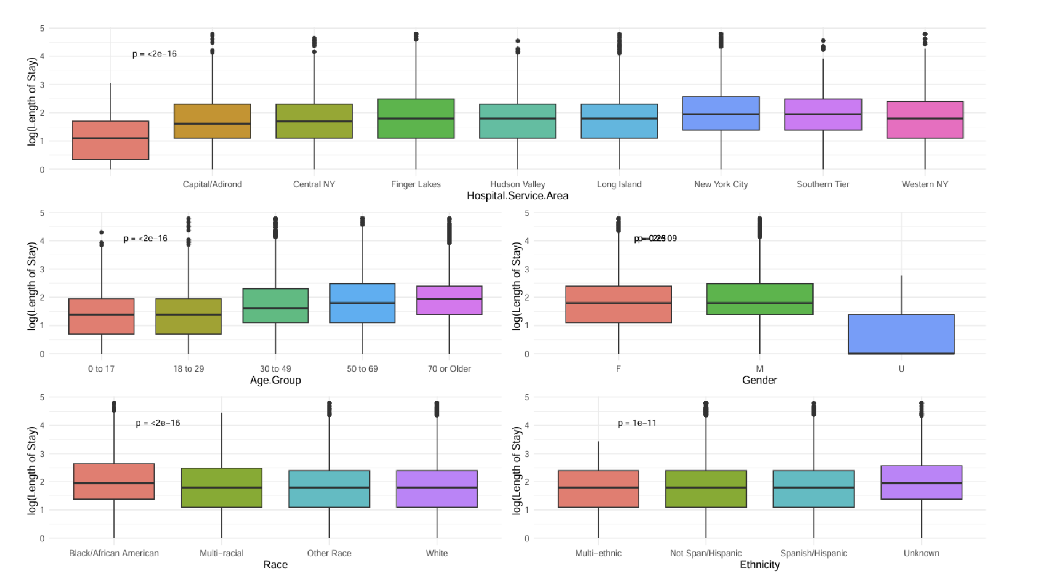
Results
Finding 1：Relationship between demographics and length of stay
1.Hospital.Service.Area, it can be seen that patients in New York City, Southern Tier have longer Length of Stay relative to other regions.
2.The older the patient, the longer the Length of Stay.
3.Male patients have a longer Length of Stay than female patients.
4.Length of Stay is longer for patients of Black/African American race.

Slide 11
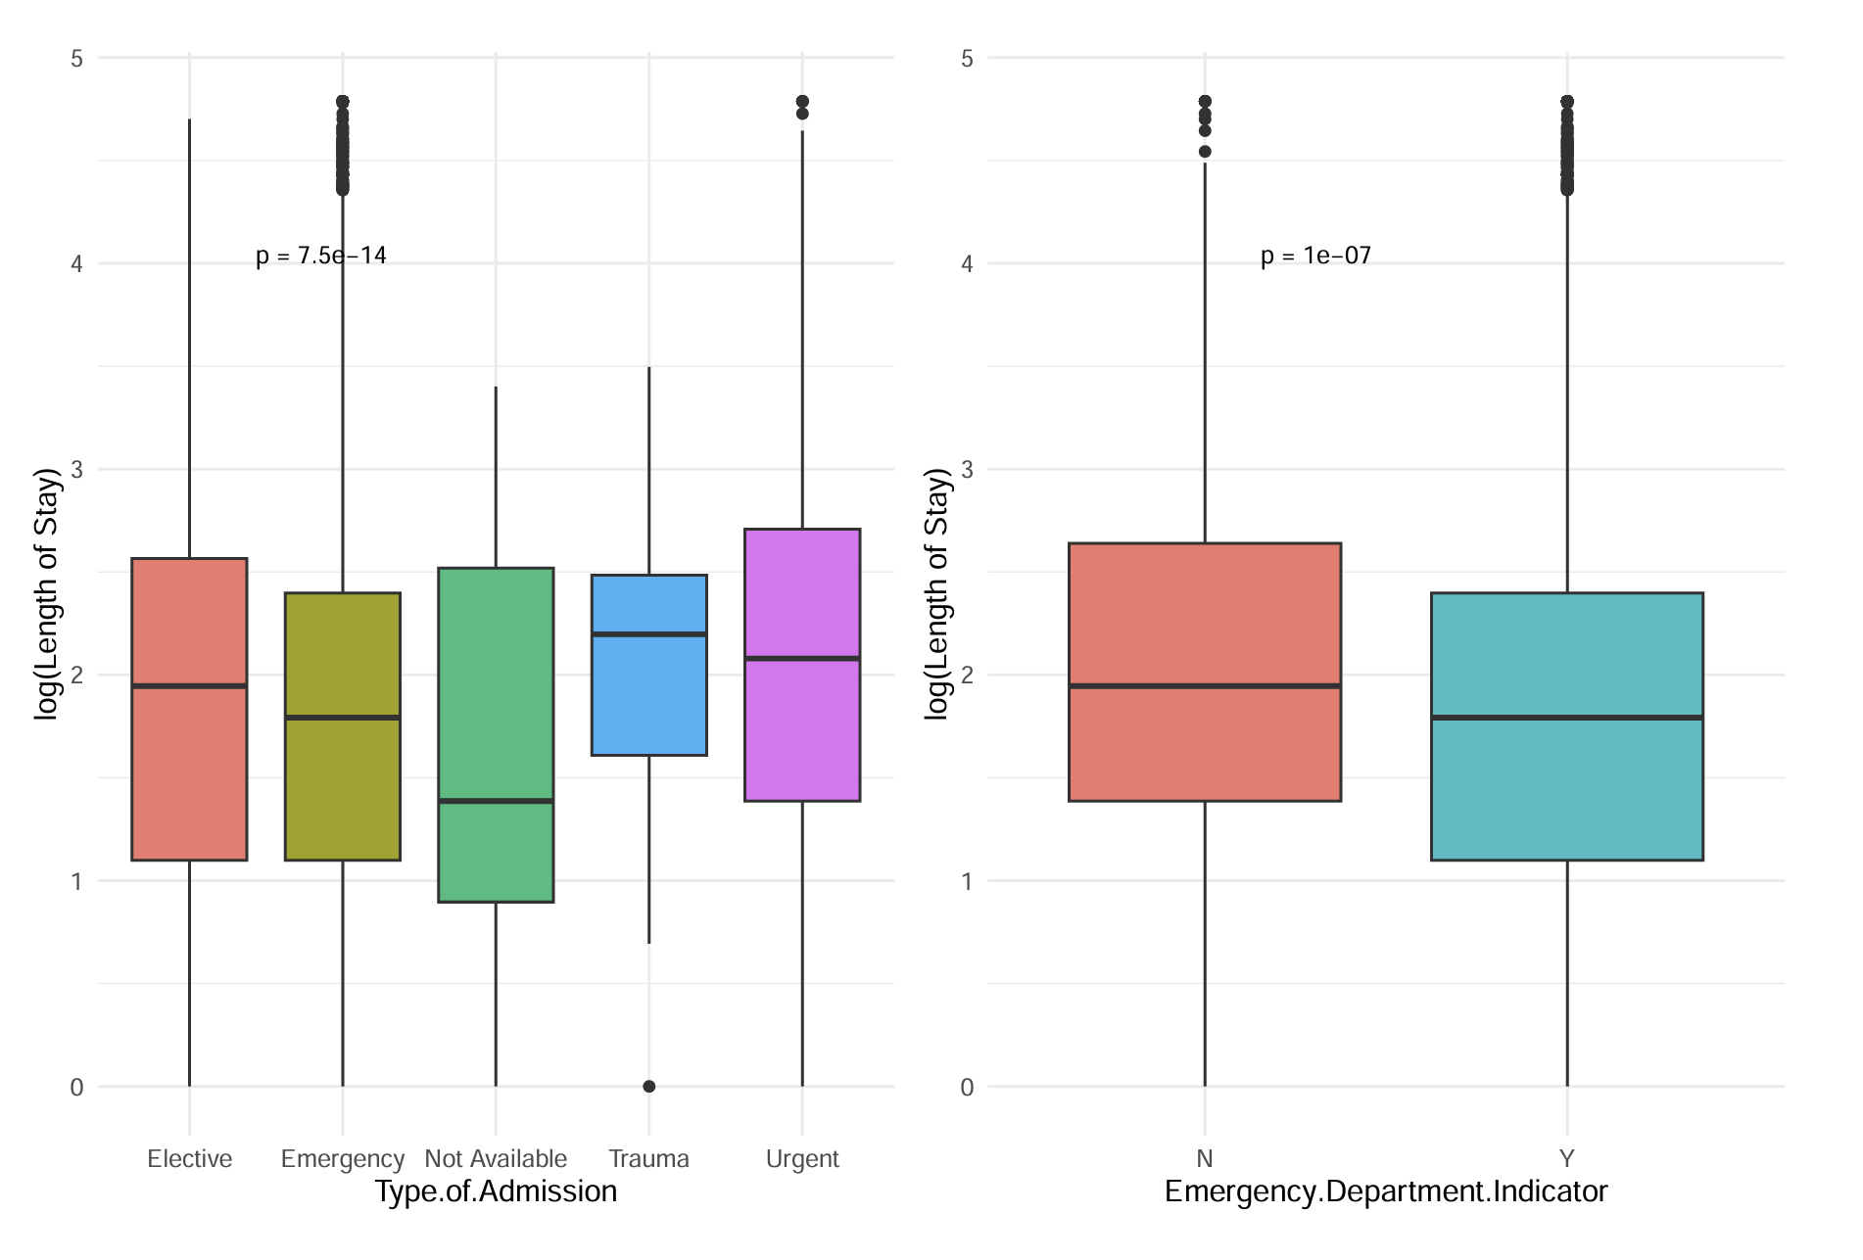
Results
Finding 2：Relationship between admission information and length of stay
- Non-emergency admissions may require multiple treatments or recovery from surgery, and these processes may result in additional hospital days. In contrast, emergency patients, although sicker, may have relatively shorter hospital stays due to more effective emergency management and tighter treatment protocols. Second, non-emergency patients may have more stringent discharge criteria, and hospitals may take longer to ensure that the patient recovers and stabilises, which in turn may affect the median number of hospital days.
- Trauma patients have a longer median length of stay compared to other types of hospitalisation. Trauma patients are usually admitted as a result of an accident or severe trauma, and these patients tend to have more complex conditions that may require multiple tests, treatments, and surgeries, which in turn increase the length of stay.

Slide 12
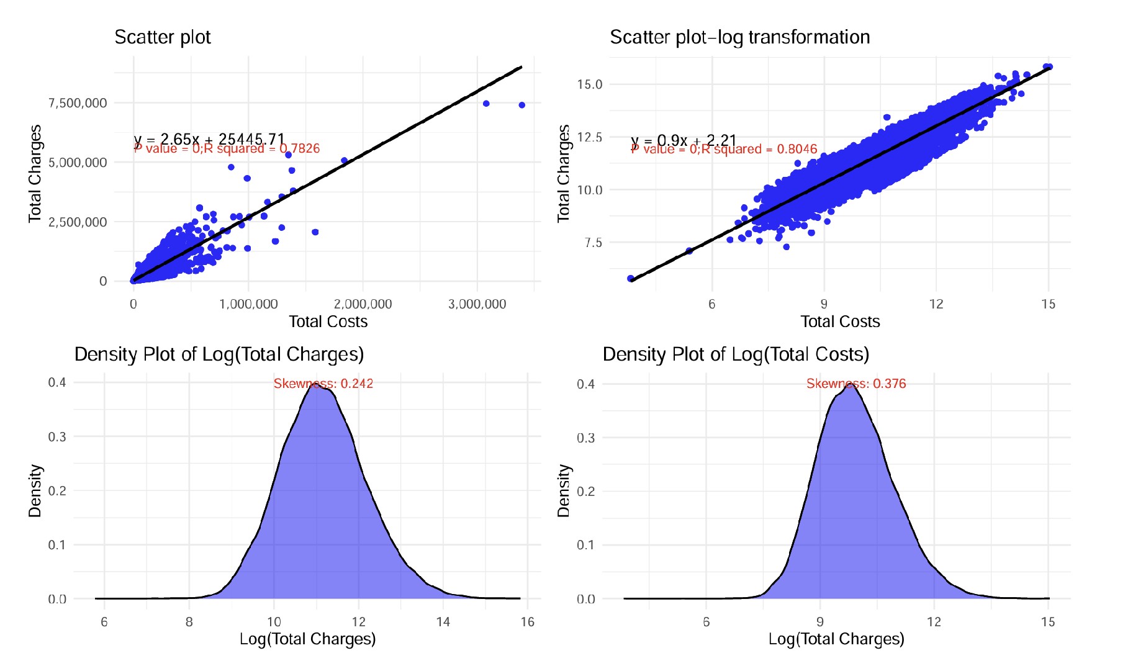
Results
Finding 3：Linear relationship between costs and fees
By building a linear regression model after logarithmic transformation of the relationship between Total Charges for hospitalization (Total Charges) and Total Costs, we observed that the two showed a significant linear relationship, and each parameter in the model had a very high level of significance (p < 2e-16), which demonstrated the validity and reliability of the model; the value of the multiple R2 is 0.8046, indicating that about 80.46% of the total cost variation can be explained by the total cost variation.
The skewness values of Total Charges and Total Costs (0.242 and 0.376, respectively) indicate that the distribution is close to normal and the data distribution is more concentrated.

Slide 13
Improvements

Slide 14
Improvements
We will make the following adjustments and improvements in our next endeavours:
1. Random forests were added to study hospitalisation time prediction to help --capture complex relationships in the data, especially non-linear relationships and interactions between variables.
2. Cross-validation and model selection
Add a cross-validation step to evaluate the performance of different models using k-fold cross-validation on the training set and select the best performing model for test set prediction.

Slide 15
Improvements
Suggest improvements.
1. Data processing and cleaning
• In-depth missing value filling
– Currently using plurality to fill in some of the missing values, statistical modeling (e.g., k-nearest-neighbor filling) or machine-learning predictions could be explored to fill in missing data more accurately to reduce the bias introduced by the filling.
• Outlier detection
– Perform outlier detection on numerical variables, such as the IQR method or the z-score method, to eliminate extreme values or fill in using the median to reduce the negative impact of outliers on model training.
2. Feature Engineering
•. Data normalization/standardization
– For some continuous variables, consider performing normalization after transformation to ensure that the data is evenly distributed and to reduce the effects of scale differences.

Slide 16
Thank You!

